Slide 1
.NET
Free. Cross-platform. Open source.
A developer platform for building all your apps.
www.dot.net

Slide 2

Presentation title
Speaker name

Slide 3
Single column of content

Slide 4
Two columns of content

Slide 5
Demo
Presenter

Slide 6
Code Sample
Code sample

Slide 7
Announcement
Value prop 1
Value prop 2
Value prop 3

Slide 8

Thanks for joining!

Slide 9








Slide 10
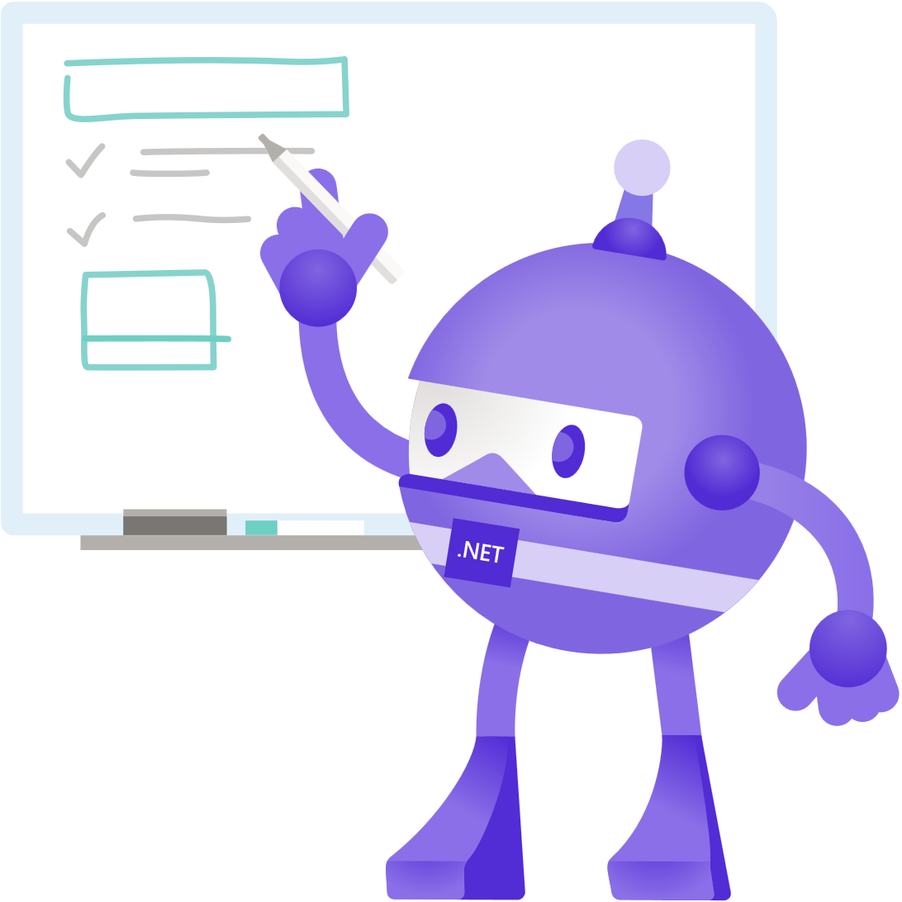







Slide 11









Slide 12


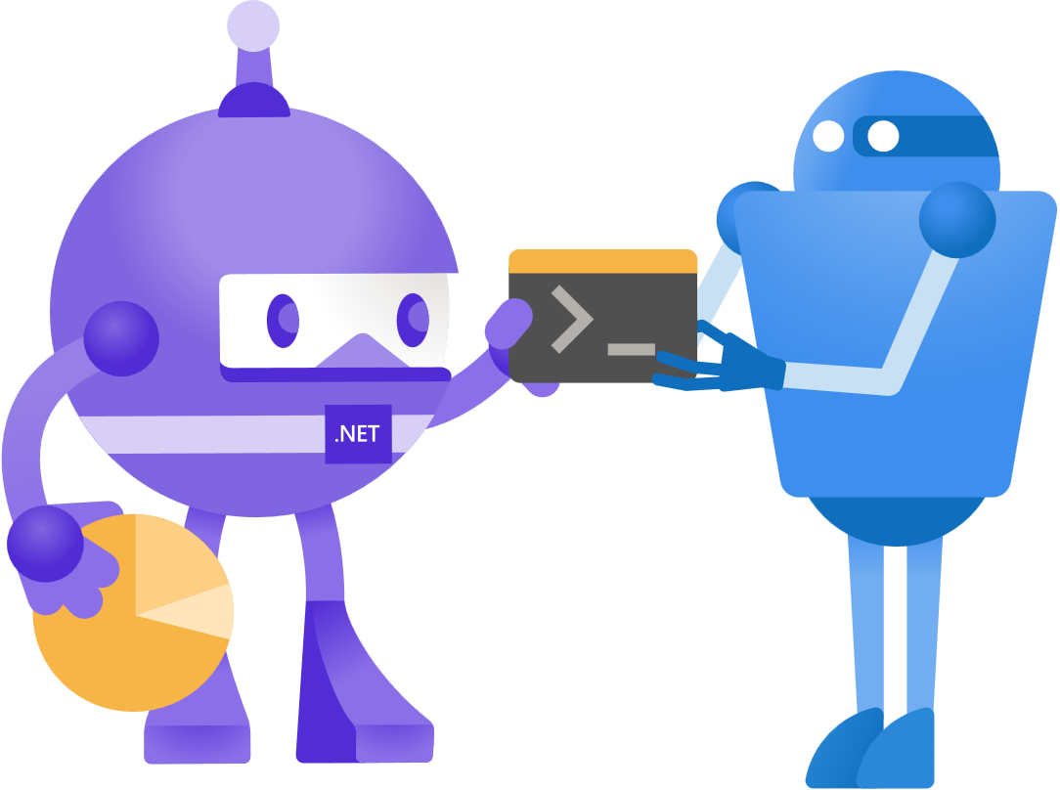




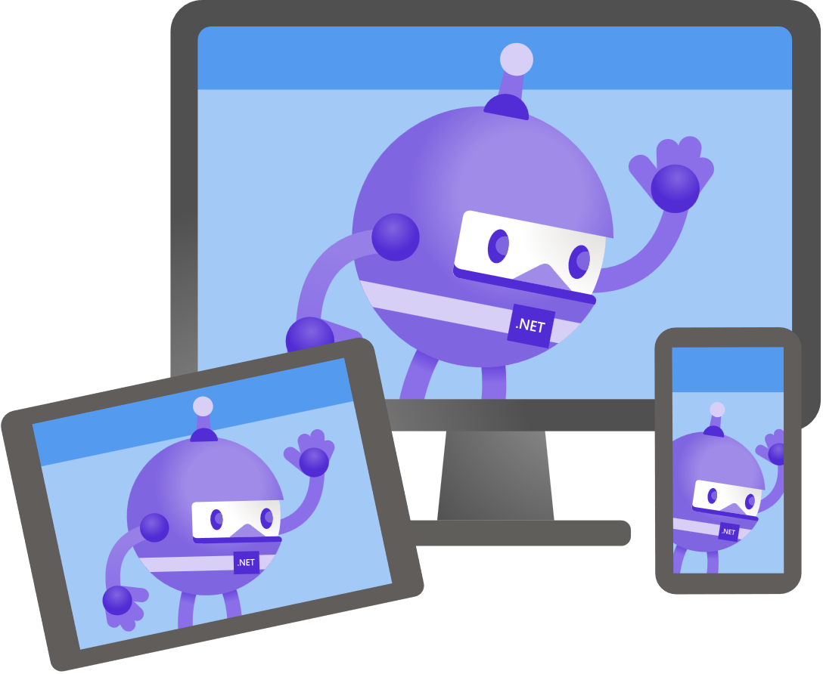

Slide 13





Slide 14


Slide 15


Slide 16


